Slide 1
Web Assembly
Binding C/C++ and the Browser VM

Slide 2
What is a “Binding”?
In computing, we sometimes want to use multiple languages in a program.
We can bind calls in one language to invoke instructions in another.
Running a Python script from C/C++
Invoking C libraries from Java
Running C/C++ code from JavaScript
Bindings let us access the benefits of multiple languages at the same time.

Slide 3
VMs, VMs, Everywhere!
Most scripting languages, including JavaScript, run in a virtual machine dedicated to the optimization of code in that language (e.g., in browsers.)
The JavaScript VM of the browser has its own bindings to browser code:
Reading and writing HTML elements
Accessing network resources
Capturing user input
Multithreading
The JavaScript VM is flexible; however, byte code VMs are typically faster.

Slide 4
WebAssembly: C/C++ for a JS World
WebAssembly (WASM) is an instruction set for the bytecode of browser VMs.
Works for compiled languages (C, C++, Rust, others)
Includes bindings for JavaScript
Requires memory management
Currently, WASM requires some JS “boilerplate”; this is temporary. ☺

Slide 5
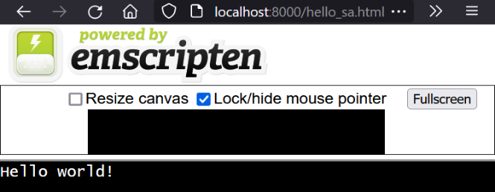
Hello WASM!
At its simplest, WASM-built C/C++ is just like native code.
#include <stdio.h>
int main()
{
printf("Hello world!\n");
}
python3 -m http.server
emcc hello.c -o hello_sa.html
Lacking any other instructions, an HTML file will be auto-generated.

Slide 6
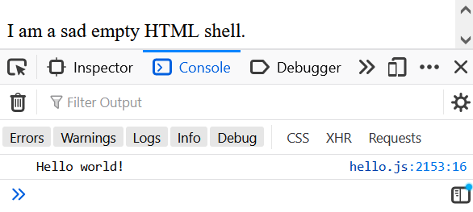
Hello…. Debug Console?
We can write a custom HTML file, but the standard out is the console by default.
<!doctype html><html><body>
<script src="hello.js"></script>
<p>I am a sad empty HTML shell.</p>
</body></html>
>emcc hello.c -o hello.js
>python3 -m http.server
To store information in HTML elements, we will need to edit them.

